Slide 1
PYTHON PROGRAMMING
LAUNCHCODE
August 16, 2025
Asfand Khan

Slide 2
Questions + Homework Review
https://github.com/Asfandyar-Khan/LaunchCode/
Contains lectures
Powerpoint files
Google Colab
Contains homeworks
To be completed prior to class
Any unfinished or challenging questions are taken up at the start of class
Please notice a new file – “Python Project Ideas”
Any questions about last week’s homework?

Slide 3
Review of Past Class
Week 5 Homework Review
Functions Continued...
The return statement – with and without variables
For Loops
For Loops only work with:
Strings, range() function, lists, or tuples
Do not work with: integers
range() function
range(start,stop,step)
Range(5) – 5 here is the stop parameter
Range(0,5) – 0 is the start, 5 is the stop
Range(0,5,2) – same as above, but 2 is the increment

Slide 4
Today We Will Cover...
Week 6 Homework Review
Knowledge Check – Functions with return values
Review of For Loop
Including the range() function
Knowledge Check – Using range() in a for loop
Lists
With examples including range function / for loop
Tuples
With examples including range function / for loop

Slide 5
Knowledge Check – Functions w/ Return
Question: Functions with Return Value (Using a Variable)
Create a function called subtract_numbers(number1, number2) that returns the result of subtracting number 2 from number 1.
Store the result in a variable called “result” and return this variable at the end of your function. When calling this function, store the result in a new variable called “answer”.
Hint: Define the function, use result = number2 – number1. Then, use return result as your final line of code.

Slide 6
Functions – Return Values
A function can send back a result using the return statement
The return statement ends the function and sends a value back to where the function was called
Returned values can be stored in variables or used directly
Functions without a return statement send back None by default
Using return makes your functions more flexible and reusable

Slide 7
Functions – For Loops
A for loop iterates over a sequence – such as a string, list, or tuple
Allows you to run a block of code repeatedly
This occurs once for each item in the sequence
Works with either lists, strings, tuples, or range()
Syntax:
for item in iterable:
# Code to be executed for each item

Slide 8
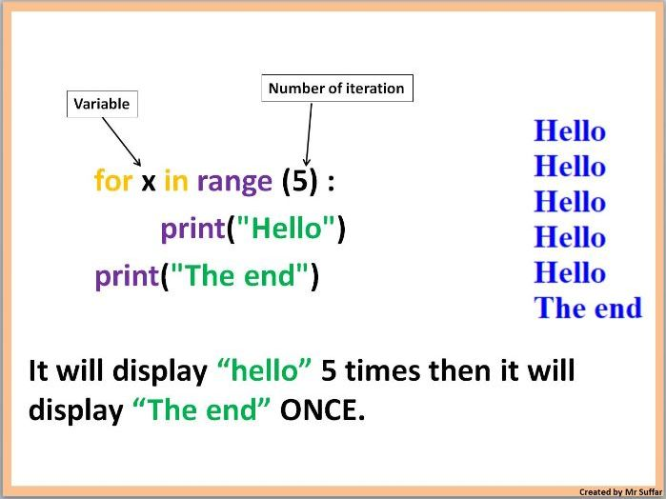
Functions – For Loops

Slide 9
Functions – For Loops, cont’d.
range() function
Commonly used in for loops
Only integers (whole numbers) can be used
Python built-in function that generates an unchangeable sequence of numbers
How is it used?
range(start,stop,step)
range(stop): this function will generate a sequence of numbers from 0 up to, but not including, stop

Slide 10
Functions – For Loops, cont’d.
range() function
range(start,stop,step): 3 parameters
range(start): initiate the sequence of numbers with the start number
range(stop): will generate a sequence of numbers from 0 up to, but not including, stop
range(step): will jump between start and stop numbers by increment of step

Slide 11
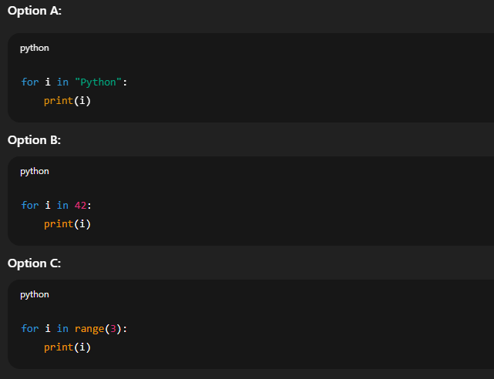
Knowledge Check – For Loops
Question: What can a for loop go through?
Which of the following will run without causing an error?

Slide 12
Knowledge Check – For Loops
Question: Using range() in for loops
Write a for loop that prints the numbers: 5,7,9,11,13
Hints:
You must use the range() function
You cannot type each number manually – use the correct start, stop, and step values
range(start,stop,step)
for variable in iterable:
# code block to repeat

Slide 13
Python Data Type - Lists
Lists
Lists are a data structure that is used to collect data items
They are mutable (changeable)
Lists maintain a defined order
The first item is given priority
Then the second item, and so on…
Items can be retrieved using index numbers (starting 0)
Items are stored in square brackets [ ]

Slide 14
Knowledge Check - Lists
Question 1: Printing a List with a Loop
Create a function called print_animals() that has a list of 3 animals inside it (for example: "dog", "cat", "rabbit"). Use a for loop to print each animal from the list.
Hint: Define the list inside the function, then use for animal in list: and print each one.
Question 2: Adding Up Numbers in a List (Return Value)
Create a function called add_list(numbers) that adds up all the numbers in a list and returns the total. Store the total in a variable called total.
When you call the function, store the result in a variable called answer and then print answer.
Hint: Start with total = 0 and use a for loop to add each number.

Slide 15
Python Data Type - Tuples
Tuples
Similar to lists, tuples are a sequence of values
They are non-mutable (unchangeable)
Tuples can store different types of data (numbers, strings, etc.)
You can access items in a tuple using index numbers (starting at 0)
Tuples are useful if you want a fixed set of values that should not be modified
Items are stored in circle brackets ( )

Slide 16
Review and Questions
Homework will be posted tomorrow!
Asfand Khan

